Slide 1


Useful VS code extensions

Slide 2

Topics
What Are VS Code Extensions?
Why Should You Use Extensions?
How to Get and Use VS Code Extensions
Must-Have VS Code Extensions for web Development

Slide 3
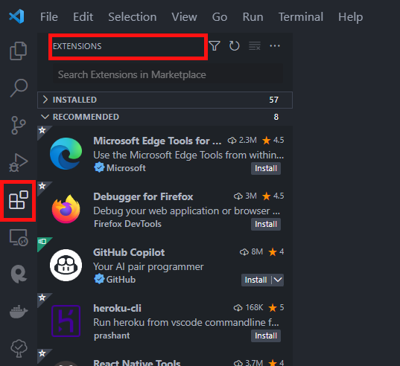
How to Get and Use VS Code Extensions
Go to Extensions: Look for the Extensions icon on the sidebar

Slide 4
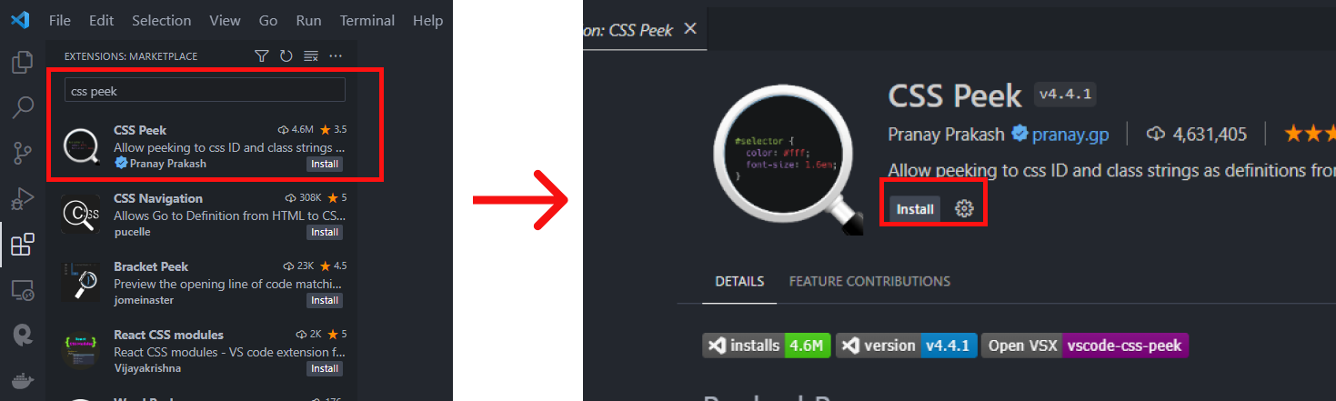
Search and Install: In the Extensions marketplace, search for the extension you want. When you find it, click "Install."

Slide 5
Must-Have VS Code Extensions for web Development
CSS peek Link
Color highlight Link
Image preview Link
HTML CSS support Link
HTML to CSS autocompletion Link
Intellisense for CSS Class Names Link
Stylelint Link

Slide 6

THANK YOU

